Slide 1

Maryline
What word would describe you best?
creative

Slide 2
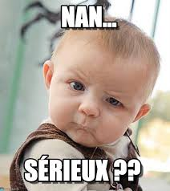

What were the first impressions you got from walking into in our organization?
Good vibes and serious

Slide 3
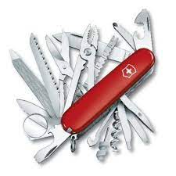
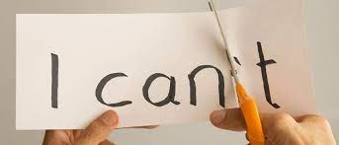
Name at least 1 of your strengths (Strong points)? And 1 of your flaws (Weak points)?
Polyvalent She miss confident

Slide 4


What are your favorite websites, apps or other resources? Why?
She like music app and now what she listening

Slide 5
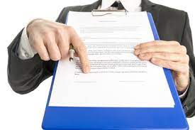
What is your worst memory from work?
forced sale : sell at any price

Slide 6

If you could change something from the past, what would it be?
nothing, thanks, my past is my present.

Slide 7
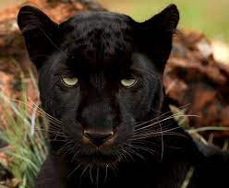
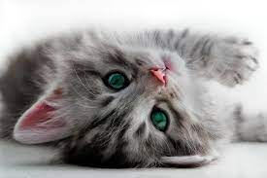
7. If you could compare yourself with any animal, which would it be and why?
A cat of course, independent but I still need others (wild but also affectionate)

Slide 8
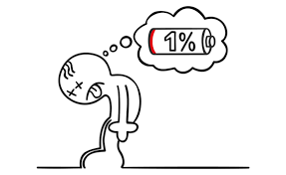
What piece of advice would you give your previous boss?
“take a breath and get some sleep”

Slide 9

What makes you uncomfortable?
when asked what makes me uncomfortable! in real, speak english….

Slide 10
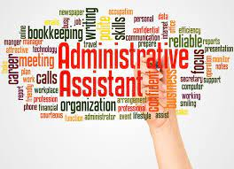
What is your experience in IT?
She was office automation mainly

Slide 11
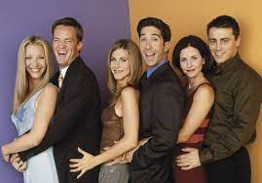


If I say “English”, what do you say?
Her First
hummm… what did you say? lol
for me it's mostly American series

